Slide 1



States Of An Object
Chapter 9

Slide 2
Today’s Agenda
States Of An Object
States Of an Object
Difference Between These States
Different Ways To Change State
Points To Remember

Slide 3
Introduction To Object States
A Java object within a hibernate application can be in one of the three states:
Transient
Persistent
Detached

Slide 4

Introduction To Object States

Slide 5
Transient State
It’s the first state of any object in the Hibernate Life cycle.
An object that is created using the new operator is in transient state.
When the object is in transient state then it will not contain any identifier (primary key value).

Slide 6
Transient State
Hibernate has no idea about transient object.
Any object which is not associated with hibernate session and does not represent a row in the database is considered as transient.

Slide 7
Example
Code:
User user = new User();
user.setName("kb");
Now user object is not associated with any session and hence it can be called as Transient object.

Slide 8
How To Bring The Object To Persistent State ?
We have to use session methods like save(), persist() or saveOrUpdate() methods to persist the transient object.

Slide 9
Persistent State
An object that is associated with the hibernate session is called as Persistent object.
When an object is in a persistent state, then Hibernate is totally aware of that object.

Slide 10
Persistent State
It also represents one row of the database and consists of an identifier value.
We can make a transient instance persistent by associating it with a Session like below:
Long id = (Long)session.save(user);
//This object is in persistent state

Slide 11
Ways To Make An Object Persistent
Object can get the Persistent state in the below 2 scenarios
Load the object from the Database using Hibernate API In this case, we load/get the existing object from the database and it will be automatically associated with the session.
Save the object into the Database using Hibernate API In this case new transient object created using “new” operator will be attached to the session and it becomes Persistent object.

Slide 12
Detached State
The detached state is given to an object that was previously “attached” to the Session (persistent state) but has now left the association with the Session.
Example:
session.close();
//All the objects will be in detached state after this line execution
All the persistent objects within the Session will get the detached state when we close the session.

Slide 13
Ways To Make An Object Detached
Object can get the Detached state in the following ways:
session.close();
session.clear();
session.evict(<object>);
* session.delete(<object>);
* session.remove(<object>);

Slide 14
Session.evict( ) v/s Session.clear()
evict() detaches a single object from the session.
clear() detaches all the objects from the session.
Calling clear() is like calling evict() on every object associated with the session

Slide 15
Ways To Make An Object Detached
The last two methods will not only remove the object from session , but also from the database.
This means that we cannot bring back these objects to persistent state by calling update() or merge() methods and if we try to do so then we will get ObjectDeletedException.
Thus we can say that remove() and delete() put the object in removed state

Slide 16
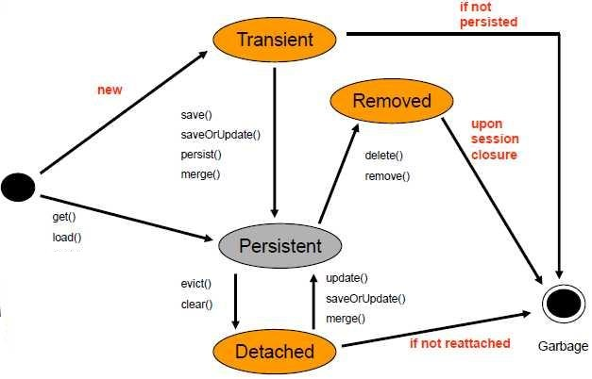
Object States

Slide 17
Why To Detach An Object ?
If any operation is taking longer time to execute, then detached object is best suitable.
Consider the scenario where application needs an input from the user, or from an external resource like an AJAX call or a webservice , then the object should be detached from the session because all these processes may take time to give input.

Slide 18
Another Point About Detached State !
If we would have done transaction commit before closing the Session then all Persistent objects will be saved into Database otherwise those persistent objects will be lost.
So object in Detached State may be present in the Database but not guaranteed to be present.
So most important thing is to commit the transaction before closing the Session.

Slide 19
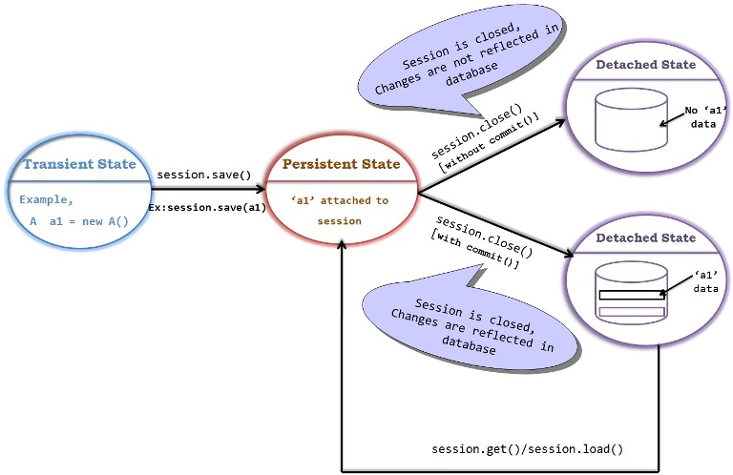
Commit V/s Non-Commit

Slide 20
How To Bring Detached Object To Persistent State ?
To bring a detached object to persistent state we can use any of the three methods update() , saveOrUpdate() and merge().
If we call them on a detached object when another object with the same id is not present in the session , then all three behave similar , i.e they will update the database with the values of the object passed as argument

Slide 21
How To Bring Detached Object To Persistent State ?
But if we call them on a detached object and some object with same id is already present in the session then update() and saveOrUpdate() will throw NonUniqueObjectException
While in this case merge() will merge / overwrite the data of the passed object on the persistent object and update the database with it

Slide 22
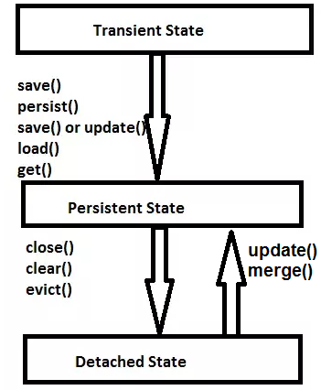
State Transition

Slide 23
Quiz
What is the state of “user” object ?
UserDetail user = new UserDetail();
user.setUserName(“Sachin Kapoor");
Answer:
Transient state

Slide 24
Quiz
What is the state now ?
Long id = (Long) session.save(user);
Answer:
Persistent state

Slide 25
Quiz
What is the state now ?
session.close();
Answer:
Detached state

Slide 26
Quiz
Will salary change reflect in the DB?
Session s=sf.openSession();
Transaction tx=s.beginTransaction();
EmployeeEx emp;
emp=(EmployeeEx)s.load(com.sca.EmployeeEx.class,id);
float newamt=emp.getEsal()+1000;
emp.setEsal(newamt);
tx.commit();
Answer:
Yes

Slide 27
Quiz
Explanation:
Even though there is no session.update involved , but still the object will be updated in the DB.
Because every object which is loaded by session.get(), session.load() is in persistent state.
It is stored in the persistence context of the session.
When tx.commit() is called, Hibernate will flush the persistence context and all not yet written insert, update and delete statements are executed.

Slide 28
Quiz
Will salary change reflect in the DB?
session.close();
session=sf.openSession();
transaction = session.beginTransaction();
emp.setSal(4000);
transaction.commit();
Answer:
No

Slide 29
Quiz
Why salary change didn’t reflect in the DB?
This is because once the current running Session
(Persistence Context) is closed all the previously managed
entities become detached.
So , any successive changes will no longer be tracked and no
automatic database synchronization is going to happen.

Slide 30
Another Diff Between persist() ,save() & saveOrUpdate()
All three methods , save() , saveOrUpdate() and persist() can bring an object from transient state to persistent state .
But if we try to use them on detached object we get different behaviour.
The method save() , will try to create a new row in the table for detached object .

Slide 31
Another Diff Between persist() ,save() & saveOrUpdate()
On the other hand the method persist() will throw a PersistentObjectException :detached entity passed to persist.
And if we call saveOrUpdate() , on a detached entity then it will simply update the same row in the database with the values of the passed object

